Slide 1
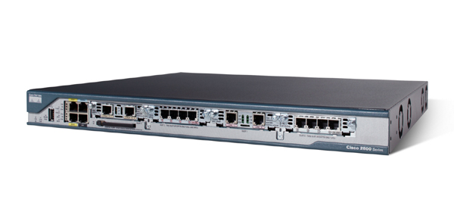
T-110.5101 Laboratory works
Router/Switch assignment
Cisco Internetworking Operating System
Fall 2011
Jere Mäkelä
8.7.2011

Slide 2
Table of Contents
General 3
CCNA Requirements 4
Laboratory 5
Laboratory works 6
Cisco cabling 7
Connectivity Problems 8
Collision and broadcast domains 9
Cisco configuration 10
Cisco interface nomenclature 11
Cisco IOS modes 14
Cisco commands 19
Cisco configuration storage 21
Cisco devices 25
Cisco device bootup 28
Port security 29
Basic switch configuration 31
Running-configuration 37
Basic switch configuration (cont.) 40
Basic router configuration 41
Basic troubleshooting 42
VLAN (Virtual LANs) and trunks 46
VLAN trunk protocol 56
VTP pruning 60
VTP configuration 64
Dynamic trunk protocol 66
VLAN creation 69
Router-on-a-stick 71
L2 redundancy 73
Private IP address spaces 74
Routing basics 75
Distance vector protocols 79
Link state protocols 82
Hybrid protocols 85
Static routes 86
Classful and classless routing protocols 90
RIP 91
ACL (Access control lists) 93
NAT 117
DHCP 130
Preassignment 133
Literature 134

Slide 3
General
Goal:
  To be able to do the basic L2/L3 configurations with Cisco IOS devices (switch, router)
  To familiarize with Cisco CLI interface (Command Line Interface)
  The commands invoked, for the most part, belong to CCNA requirements
  If you want to become proficient with Cisco IOS, the best place to start with is one of the reference books and buy a simulator, if you don’t have an access to Cisco devices
Preassignment
  Subnetting with VLSM. The preassignment is in an Excel file ”VLSM-exercise”. Preassignment is worth 2 points
User commands:
  The user typings are in bold text

Slide 4
CCNA requirements
CCNA knowledge base is a solid foundation, which gives you a reasonable knowledge to work with small and medium-size networks
Passing CCNA certificate is quite a big task. You need to memorize a 1000p book and you need to be able to subnet in your head and fast!
CCNA topics:
  Internetworking, OSI model, TCP/IP model
  Subnetting, VLSM (Variable length subnet mask) and TCP/IP troubleshooting
  Cisco IOS and SDM (Security Device Manager: browser based user interface)
  Managing a Cisco network
  IP routing (static routing, RIP, IGRP, EIGRP, OSPF)
  Spanning Tree Protocol, EtherChannel (L2 redundancy and loop-free topology)
  Virtual LANs (VLAN)
  Security (ACL – Access Control List)
  NAT (Network Address Translation)
  Cisco Wireless technologies
  IPv6
  WAN (Wide Area Networks)

Slide 5
Laboratory
The IOS commands are done with a simulator:
  CCNA Network Visualizer 6.0
  The commands supported by the simulator is a subset of CCNA commands. Some commands do not work correctly or not at all
  If you have to check the commands supported, consult:
    http://www.routersim.com/CCNA6_Supported_Commands.html
The switch model 2960 and the router model 2811 are employed in tasks
In order to do something useful with Cisco devices, you need to know a whole lot of things before delving into configurations. This makes this assignment challenging and tedious
If you want to do the easy way, you can copy&paste from the lab book ”CCNA Portable Command Guide” but what is the use?

Slide 6
Laboratory works
#1 Basic Switch configuration with port-security and telnet
  The reason we configure telnet instead of SSH is that the simulator only supports telnet sessions
  5p
#2 VLAN and Router-on-a-stick
  4p
#3 Routing and ACL
  Static routing and RIPv2 are employed. Other routing protocols, such as OSPF, are harder to configure and were left outside because of a short time per lab
  10p
#4 NAT + DHCP
  8p
The maximum points from this lab is 29p
If you are well prepared, each work should take no more than 30-45 minutes making this a 2-3 hour assignment
Write down the complete IOS command sequence for each task before coming to the lab. Be particularly accurate, in which Cisco IOS mode you have to be and how to move between the modes. Before invoking the commands, you should check first the CCNA Portable Command Guide at the lab
Outside the lab times, a group can borrow the CCNA Portable Command Guide for three hours
The reference book: Richard Deal: CCNA Study Guide. 3rd edition can also be borrowed if some things in these slides stay blur
Either you prepare well for the labs or you fail, that’s guaranteed!

Slide 7
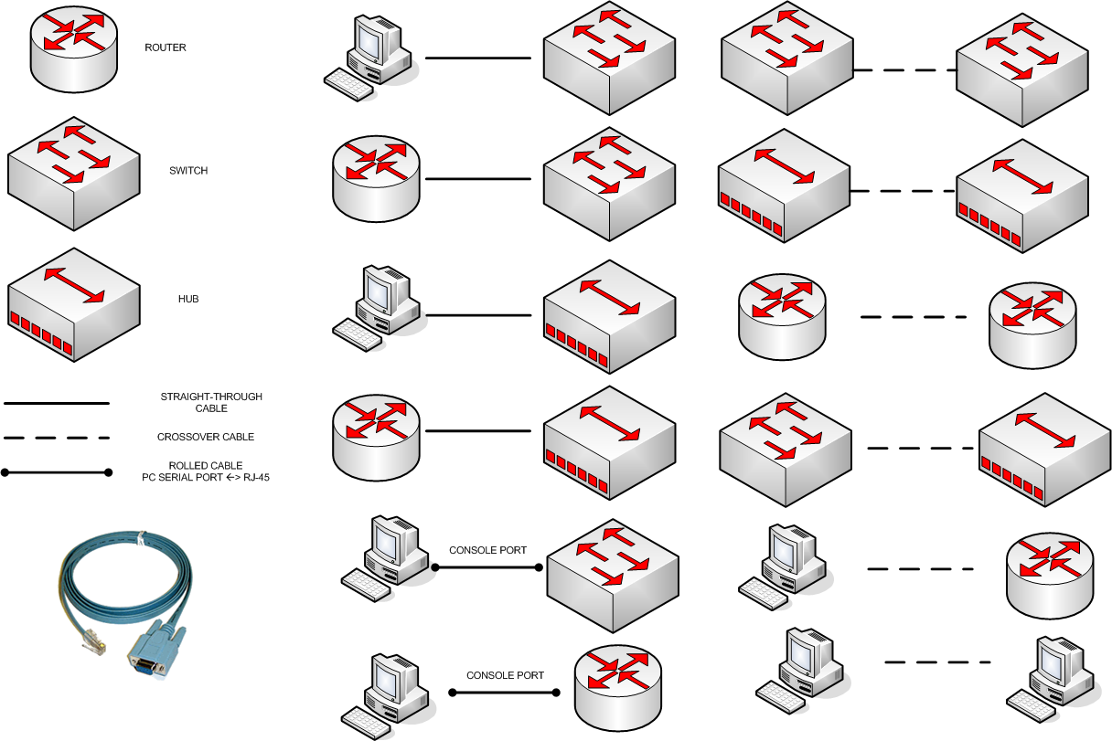
Cisco cabling

Slide 8
Connectivity problems
You do need a crossover cable between Cisco switches. This is a common source of connectivity failures. If CDP (Cisco Discovery Protocol) shows no a neighbor present, even the power is on in both devices and there is a cable connecting these two, check that the cable is a crossover cable

Slide 9
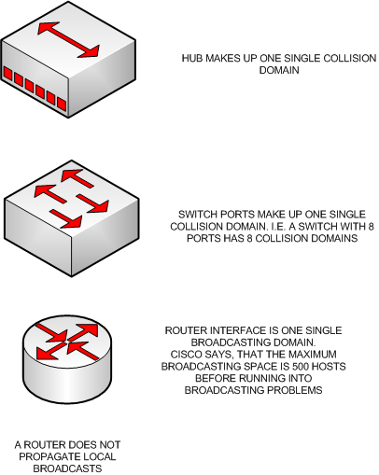
Collision and broadcast domains

Slide 10
Cisco configuration
Connections:
  Console port, Auxiliary Port, Telnet, SSH, Browser (SDM), SNMP, Cisco Works and Cisco Managed Services Solutions
  Telnet and SSH are called VTY access (virtual type terminal)
Console port:
  Hyper Terminal or PuTTY
  Speed: 9600 bps
  Data bits: 8
  Stop bits: 1
  Parity: None
  Flow Control: None

Slide 11
Cisco interface nomenclature (1/3)
Switch 2950, 2960
  Fixed interfaces
  ”Type slot#/port#”
    Type: ethernet (10M), fastethernet (100M), gigabit
    Slot# is always 0
    Port# starts from 1
    i.e. ”fast 0/1” or ”f0/1”
Note, that you can shorten just about any IOS command or option provided that the abbreviated command is non-ambiguous

Slide 12
Cisco interface nomenclature (2/3)
Routers and some switches (6500)
  Fixed or modular interfaces
  For fixed interfaces:
    ”Type port#”
      Type: atm, asynch, bri, ethernet, fastethernet, gigabitethernet, serial
      Port# starts from 0
      i.e. ”serial 0” or ”s0”
  For modular interfaces:
    ”Type slot#/port#
      Type: atm, asynch, bri, ethernet, fastethernet, gigabitethernet, serial
      Slot# starts from 0
      Port# starts from 0
      i.e. ”giga 0/0”, ”fast 0/1” or ”f0/1”

Slide 13
Cisco interface nomenclature (3/3)
To enter into an interface configuration mode, you have to type one of the following:
  Router(config)#interface ethernet 0/1
  Router(config)#interface ethernet0/1
  Router(config)#int e 0/1
  Router(config)#int e0/1
  Note, that you must be in the global configuration mode before entering an interface configuration
Router interfaces are shut down by default, switch ports are open by default. The VLAN interfaces of a switch are also shut down by default
  To open the interface, type:
    Router(config-if)#no shutdown
  To shut down the interface, type:
    Router(config-if)#shutdown
You can view all the physical interfaces of a router or a switch by typing:
  Router#sh ip interface
Cisco IOS commands are negated or revoked by typing ”no” before the command

Slide 14
Cisco IOS modes (1/5)
Login
  Upon connecting to the console port
  Hit Enter to enter the User Exec
User Exec
  The prompt becomes: Router>
  Basic and limited access to IOS
  Simple monitoring and troubleshooting such as: ”show ?”, ”telnet”, ”ping”, ”traceroute”
  Type ”Router>enable” (or ”Router>en” for short) to enter Privileged Exec
  Type ”logout” or ”exit” to return to login
Privileged Exec
  The prompt becomes: Router#
  High-level management to IOS
  Includes all the commands from User Exec
  You can do most things except configuring the device
  Type ”Router#configure terminal” (or ”Router#conf t” for short) to enter the configuration mode
  Type ”disable” or ”disa” to return to User Exec
  Type ”logout” or ”exit” to return to login
  Reload to boot up the device

Slide 15
Cisco IOS modes (2/5)
Configuration or global configuration mode
  The prompt becomes: Router(config)#
  Debug
  Hostname
  Enable secret
  Ip route
  ACL
  Type exit, end or cntl-z to return to Privilege Exec

Slide 16
Cisco IOS modes (3/5)
  To enter the interface configuration mode:
  Router(config)#interface fastethernet 0/1 - OR - Router(config)#int f0/1
    The prompt becomes: Router (config-if)#
      Ip address + mask
      Encapsulation
      shutdown / no shutdown (or shut for short)
      Type exit to return to Configuration mode, end or cntl-z to return to Privileged Exec mode
  Router engine commands
  Router(config)#router rip|ospf|igrp|eigrp
    The prompt becomes: Router(config-router)#
    Network etc.
  Line commands i.e.
  Router(config)#line con 0
    The prompt becomes: Router(config-line)#
    Password
    Login
  Line console is the CLI interface to the device. The serial port configuration was introduced earlier. The cable type is: ”Serial (PC) – RJ45”

Slide 17
Cisco IOS modes (4/5)
  Telnet settings:
    Router(config)#line vty 0 ?
    The prompt becomes: Router(config-line)#
    Type the question mark, if you don’t know the number of VTY lines. The number of VTY lines is the number of maximum allowed, simultaneous Telnet sessions
      Password
      Login
  SSH configuration is not included in this course. But in the real life, SSH should be preferred over Telnet because of the security
  SSH configuration is a very straightforward operation
  You can always exit from any mode by typing ”exit”
  cntl-z returns straight back to the privileged exec mode

Slide 18
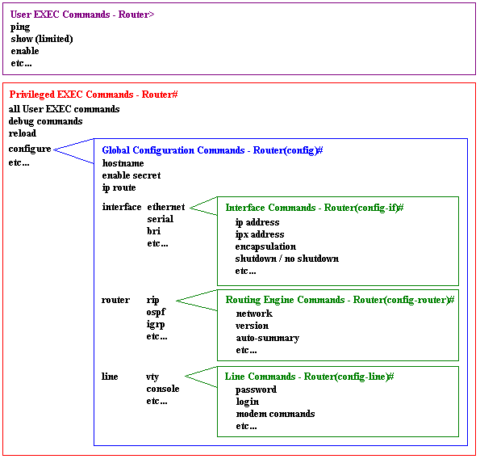
Cisco IOS modes (5/5)
Figure: http://www.cisco.com/warp/cpropub/45/tutorial.htm

Slide 19
Cisco commands (1/2)
Context-sensitive help:
  Router>?
    Shows all the possible commands in this mode
    Type Spacebar to scroll down one page at a time
    Type Enter to scroll down one line at a time
  Router>e?
    Shows all the commands starting with ”e”
  ^ invalid input detected
  Hit UP and DOWN ARROW to browse command history
  To negate the command, you just typed, browse the command from the command history, type ctrl-a (to place the cursor in the beginning of the line) and type ”no” before the command
  Router#clock ?
    set Set the time and date
  Router#clock set ?
    Hh:mm:ss Current Time
    Router#clock set 15:00:00 ?
    <1-31> Day of the month
    MONTH Month of the year
    Router#clock set 15:00:00 17 Mar ?
    <1993-2035> Year
    Router#clock set 15:00:00 17 Mar 2011
    Router#show clock

Slide 20
Cisco commands (2/2)
The most important hot keys:
  cntl-a – Moves the cursor to the beginning of the line
  cntl-e – Moves the cursor to the end of the line
  up arrow – Recalls the last command
  down arrow – Recalls the most previously executed command
  tab – IOS completes the word (if the characters typed form a unique start for a command)
  ? – Presents all the possible commands or parameters
The rest of the hot keys:
  esc-b – Moves the cursor back one word at a time
  esc-f – Moves the cursor forward one word at a time
  left arrow – Moves the cursor back one character at a time
  right arrow – Moves the cursor forward one character at a time
  cntl-d – Deletes the character the cursor is under
  backspace – Deletes the character preceding the cursor
  cntl-r – Redisplays the current line
  cntl-u – Erases the line completely
  cntl-w – Erases the word the cursor is under
  cntl-z – Returns to the Privilege Exec mode from Configuration mode
  $ - Indicates that there are more characters to the right of the $

Slide 21
Cisco configuration storage (1/4)
running-config
  RAM
  Working configuration
  Stores all the configurations you invoke
startup-config
  NVRAM or flash
  non-volatile configuration
  After reload or power off, the device copies ”startup-config” into ”running-config”
Typically you want to save the given configurations into the non-volatile memory by:
  Router#copy run start

Slide 22
Cisco configuration storage (2/4)
Configuration register
  In NVRAM
  Register affects how the router boots up
  ”Router>sh version” shows the IOS version, system image file and the configuration register value
  ”Router(config)#config-register 0xHEX_VALUE” alters the register content
  The default value is 0x2102
  With the configuration register you can recover the password, in case you have forgotten it
Flash
  Default location of IOS images
  Can have backup config files
  Switch#sh flash

Slide 23
Cisco configuration storage (3/4)
Router#show run
Router#show start
Router#copy run start (from run to start)
Router#copy start run (from start to run. Obs! A merge operation, not a replacement)
Router#copy start tftp (copy start to TFTP server)
Router#copy tftp run (copy run from TFTP server)
Router can have multiple copies of configuration files with different names in the flash memory. However, it is more advisable to copy them to a tftp/ftp server
  Router#copy run|start flash:FILE_NAME

Slide 24
Cisco configuration storage (4/4)
To wipe out the router configuration:
  Router#erase start
  Router#reload
To wipe out the switch configuration:
  Switch#erase start
  Switch#delete vlan.dat
  Switch#reload
To wipe out i.e. a backed-up config:
  Switch#delete flash:FILE_NAME
To back up an IOS image:
  Switch#copy flash tftp
To load a new IOS image:
  Switch#copy tftp flash
  Switch#reload

Slide 25
Cisco devices (1/3)
Ports and LEDs
No power on/off switch!
2960 Front
SYST
RPS
STAT
DUPLX
SPEED
MODE
2960 Rear
Push button
RJ-45
Console port
FAN
Exhaust
RPS Outlet
Power input

Slide 26
Cisco devices (2/3)
System LED
  Green: The system is up and running
  Amber: The system has experienced a malfunction
  Off: The system is powered down
RPS (Redundant power system)
  Green: RPS is attached and operational
  Amber: RPS is installed but not operational
  Flashing amber: Both the internal and external (RPS) installed, but RPS is providing power
  Off: RPS is not installed

Slide 27
Cisco devices (3/3)
SYST
RPS
STAT
DUPLX
SPEED
MODE
The meaning of the LED above the port depends on the LED’s
Mode setting.
When the Stat LED is lit, the port LEDs show the port status
- Green: A powered-up host connection
- Flashing green: Traffic is running in the port
- Flashing green and amber: An operational problem
- Amber: The port has been manually disabled, is in a blocking
STP state or disabled because of a security breach
If you push the MODE button once, the MODE LED will change to Dublx.
The port LEDs reflect the dublex setting:
Off: Half-duplex
Green: full-duplex
By pressing the MODE button again, the MODE LED will change
to Speed. The port LEDs reflect the speed setting:
Off: 10 Mbps
Green: 100 Mbps
Blinking green: 1000 Mbps

Slide 28
Cisco device bootup
After power up:
  #1 Flash is validated
  #2 IOS is found, uncompressed and loaded. Note that there can be more than one IOS image. By default, the first IOS image is loaded but can be changed with ”boot system flash” command
  #3 POST checks different components to see that they are operational (takes about a minute). First, system LED is off. The system LED turns into green if everything is ok. The amber usually is catastrophic to a switch
  #4 Configuration is found and applied
  #5 User is presented the User Exec prompt if hooked with a terminal emulator
  If a configuration is missing in NVRAM, the switch starts up a setup script. You can start a setup later with a ”setup” command in Privilege Exec. With setup, however, you can do only the very basics
  You can reload IOS by ”reload” command (remember to save your config before that:
    Switch#copy run start
    Switch#reload

Slide 29
Port security (1/2)
Starting in IOS 12.1 (the latest commercial IOS version is 15.0)
If and when you want to harden Cisco IOS, the port security is in your toolbox
Works only with access ports, not with:
  Trunk port, Switch port analyzer port or EtherChannel port
Access port connects a host (or several hosts, if a hub is present). Trunk port connects between switches or routers
Setup per interface as follows:

Slide 30
Port security (2/2)
Configure a switch port to an access port with a VLAN number
  Switch(config)#int fast 0/0
  Switch(config-if)#switchport mode access
  Switch(config-if)#switchport access vlan VLAN#
Enable port-security to this port
  Switch(config-if)#switchport port-security
Define the maximum number of hosts, that can be connected to this switch port (typically 1)
  Switch(config-if)#switchport port-security maximum VALUE
Define, what will be the action, if the port-security is violated (too many hosts or a host with non-allowed MAC-address is found). Typically you want to shut down the port
  Switch(config-if)#switchport port-security violation protect|restrict|shutdown
After a shutdown:
  Switch(config-if)#no shutdown
Attach a MAC-address of a legal host
  Switch(config-if)#switchport port-security mac-address MAC-ADDRESS
OR
Define the mac-address to be sticky, which attaches the first encountered mac-address
  Switch(config-if)#switchport port-security mac-address sticky
Check the port-security settings:
  Switch#sh port-security

Slide 31
Basic switch configuration (1/6)
Configure:
  Switch name
  Clock
  Secret password (encrypts the password in the configuration file). Required, when entered into the privileged mode
  Login banner. The text that a user gets, when logging in the device. Do NOT use a word ”welcome”. This is an invitation to a hacker and might lead in troubles if you have to go to the court
  Disable DNS queries. DNS query is done and telnet invoked, if the IOS does not recognize the command you type. This is pretty annoying when you do a typo. The command is: ”no ip domain-lookup”
  Console port password + login
  ”logging synchronous” command, which inhibits the garbled text on a command line
  The idle time, after which the console logs off
  Note, that the simulator does not support ”no ip domain-lookup” or ”logging synchronous” commands. You have to know these nevertheless
  VTY password + login. The number of allowed VTY connections depends on the switch model

Slide 32
Basic switch configuration (2/6)
Configure (cont.):
  IP default gateway. This is the IP address of the router’s interface that connects into this switch
  Management VLAN. All the switches are configured to belong into a single management VLAN. That is one common subnet. The IP address of the management VLAN is required, when the switch is configured with VTY. Note that the VLAN interface is shut by default, so you need to open (enable) it with ”no shut” command
  By default, all the switch ports belong to VLAN 1. If you don’t configure ports, they belong by default to VLAN 1 and are access ports
  Port-security settings. You must configure the switch port to an access port (vs. trunk). Then you enable the port-security. Then you can set the maximum number of hosts, that can be connected into this port (number of MAC addresses). You can also set the switch port to be sticky, that is, you don’t have to program the allowed MAC address (or addresses) but let the switch learn the first encountered MAC address on a port and attach it to the allowed address. You also configure the action that is done after the port violation. Typically this would be shutting down the port
  Finally, copy running-config into startup-config with ”Router#copy run start”

Slide 33
Basic switch configuration (3/6)
Switch Con0 is now available
Press RETURN to get started!
Switch>en
Switch#conf t
Enter configuration commands, one per line. End with CNTL/Z
Switch(config)#no ip domain-lookup
^
% Invalid input detected at '^' marker. OBS! Does not work in the simulator
Switch(config)#hostname MY_SWITCH
MY_SWITCH(config)#enable secret cisco
MY_SWITCH(config)#banner login $
Enter TEXT message. End with the character '$'.
Authorized personnel only!
Violators will be prosecuted
to the fullest extent of the law.
$

Slide 34
Basic switch configuration (4/6)
MY_SWITCH(config)#line
MY_SWITCH(config)#line ?
<0-16> First Line number
console Primary terminal line
vty Virtual terminal
MY_SWITCH(config)#line con
MY_SWITCH(config)#line console 0
MY_SWITCH(config-line)#logging synchronous
^
% Invalid input detected at '^' marker. OBS! Does not work in the simulator
MY_SWITCH(config-line)#passwor
MY_SWITCH(config-line)#password cisco
MY_SWITCH(config-line)#login
MY_SWITCH(config-line)#exec-timeout 5 0
^
% Invalid input detected at '^' marker. OBS! ´Does not work in the simulator
MY_SWITCH(config-line)#exit
MY_SWITCH(config)#line
MY_SWITCH(config)#line ?
<0-16> First Line number
console Primary terminal line
vty Virtual terminal
MY_SWITCH(config)#line vty 0 ?
<1-15> Last Line number
<cr>
MY_SWITCH(config)#line vty 0 15

Slide 35
Basic switch configuration (5/6)
MY_SWITCH(config-line)#password cisco
MY_SWITCH(config-line)#login
MY_SWITCH(config-line)#exit
MY_SWITCH(config)#ip de
MY_SWITCH(config)#ip default-gateway 10.0.0.1
MY_SWITCH(config)#inte
MY_SWITCH(config)#interface vlan 10
MY_SWITCH(config-if)#ip add
MY_SWITCH(config-if)#ip address 10.0.0.2 255.255.255.0
MY_SWITCH(config-if)#no shut
MY_SWITCH(config-if)#exit
MY_SWITCH(config)#int
MY_SWITCH(config)#interface fas
MY_SWITCH(config)#interface fastethernet 0/1
MY_SWITCH(config-if)#des
MY_SWITCH(config-if)#description Link to Moscow
MY_SWITCH(config-if)#swi
MY_SWITCH(config-if)#switchport por
MY_SWITCH(config-if)#switchport port-security
Command rejected: Not eligible for secure port.
MY_SWITCH(config-if)#swit
MY_SWITCH(config-if)#switchport mode
MY_SWITCH(config-if)#switchport mode acc
MY_SWITCH(config-if)#switchport mode access
MY_SWITCH(config-if)#switchport access vlan 10
MY_SWITCH(config-if)#switchport port-security
VLAN interface of a switch is shut down by default. Open it with ”no shut” commannd

Slide 36
Basic switch configuration (6/6)
MY_SWITCH(config-if)#swi
MY_SWITCH(config-if)#switchport por
MY_SWITCH(config-if)#switchport port-security max
MY_SWITCH(config-if)#switchport port-security maximum 1
MY_SWITCH(config-if)#swi
MY_SWITCH(config-if)#switchport por
MY_SWITCH(config-if)#switchport port-security viol
MY_SWITCH(config-if)#switchport port-security violation shu
MY_SWITCH(config-if)#switchport port-security violation shutdown
MY_SWITCH(config-if)#swi
MY_SWITCH(config-if)#switchport por
MY_SWITCH(config-if)#switchport port-security mac
MY_SWITCH(config-if)#switchport port-security mac-address stic
MY_SWITCH(config-if)#switchport port-security mac-address sticky
MY_SWITCH(config-if)#cntl-z
MY_SWITCH#copy run start
Destination filename [startup-config]?
Building configuration...
[OK]
MY_SWITCH#

Slide 37
Running-config (1/3)
MY_SWITCH Con0 is now available
Press RETURN to get started!
Authorized personnel only!
Violators will be prosecuted
to the fullest extent of the law.
User Access Verification
Password: password
MY_SWITCH>en
Enter password: *****
MY_SWITCH#sh run
Building configuration...
Current configuration : 918 bytes
!
version 12.2
no service pad
service timestamps debug uptime
service timestamps log uptime
no service password-encryption
!
hostname MY_SWITCH
!
enable secret 5 $1$u76B$IOFVJ7VxfVXYVpGDrFTcI0

Slide 38
Running-config (2/3)
no aaa new-model
system mtu routing 1500
no ip subnet-zero!
no file verify auto
spanning-tree mode pvst
spanning-tree extend system-id
!
vlan internal allocation policy ascending
!
interface FastEthernet0/1
description "Link to Moscow"
switchport mode access
switchport port-security
switchport port-security maximum 1
switchport port-security mac-address sticky
!
interface FastEthernet0/2
interface FastEthernet0/3
interface FastEthernet0/4
interface FastEthernet0/5
interface FastEthernet0/6
interface FastEthernet0/7
interface FastEthernet0/8
interface GigabitEthernet0/1

Slide 39
Running-config (3/3)
interface Vlan10
ip address 10.0.0.2 255.255.255.0
no ip route-cache!
ip default-gateway 10.0.0.1
ip http server!
control-plane!
banner login ^C
Authorized personnel only!
Violators will be prosecuted
to the fullest extent of the law.
^C
line con 0
password cisco
login
line vty 0 4
password cisco
login
line vty 5 15
password cisco
login
end
MY_SWITCH#

Slide 40
Basic Switch configuration (cont.)
In order to access other devices in other VLANs, or allow VTY connection to this host, an IP address and a default gateway must be configured with a switch
In switches, the IP address settings are done per VLAN (virtual lan), not physical interfaces
VLAN 1 is the default management VLAN. The management protocols of a switch (CDP, VTP, DTP) occur within the switch’s management VLAN
You should use a different VLAN# than 1 to manage your switches. Always use the same management VLAN# in all switches, for example VLAN 10
For clarity, name your management VLAN as ”Management”
In routers, the IP address settings are done for interfaces

Slide 41
Basic router configuration
Very much like that of the switch, except that you configure each interface with IP settings
You don’t configure ”ip default-gateway” with routers and you don’t configure management VLAN
Each interface of a router is a separate network of a subnet. The IP address of the router interface becomes the default gateway for the subnet. Typically, you choose the first available IP address for a router interface
  Router#conf t
  Router(conf)#int f0/0
  Router(conf-if)#ip address 192.168.1.1 255.255.255.0
  Router(conf-if)#no shut
  Router(conf-if)#exit
  Router(conf)#int serial0
  Router(conf-if)#ip address 192.168.2.1 255.255.255.0
  Router(conf-if)#no shut
  Router(conf-if)#clock rate 64000
  Router(conf-if)#cntl-z
  Router#copy run start
Note, that ”clock rate” command is applied only with serial interfaces that have a DCE cable plugged into it. DTE (Data termination equipment) and DCE (Data communications equipment) are typically used in WAN connections
Use ”show interfaces” or ”show ip interfaces” to verify the configuration
EIGRP and OSPF need a bandwidth value for a router interface:
  Router(config)#int serial 0/0
  Router(config-if)#bandwidth rate_in_kbps
Name resolution is done either statically (name to IP) or dynamically (DNS)
  ip name-server IP_address_of_DNS_server
Typically, DNS is disabled in routers:
  Router(config)#no ip domain-lookup
Router#show hosts

Slide 42
Basic troubleshooting (1/4)
OSI Reference Model Layer |  |  | Command
L2 |  |  | show ip arp
L2 |  |  | show interfaces
L2 |  |  | show cdp neighbors
L3 |  |  | ping
L3 |  |  | traceroute
L7 |  |  | telnet
L2-L7 |  |  | debug

Slide 43
Basic troubleshooting (2/4)
Switch#sh ip arp
  Output shows the IP – MAC bindings and the interface
CDP – Cisco Discovery Protocol
  CDP shows information only from the directly connected devices
  You can test L2 connectivity with CDP
  The following info is gathered:
    Name of the device (hostname)
    IOS version
    HW capabilities (routing, switching, bridging)
    HW platform, such as 2960
    L3 addresses of the device
    The interface on which the CDP update was generated
  Switch#sh cdp neighbors
  Switch#sh cdp nei detail
  You can disable or enable CDP globally or per port. You should disable CDP in the port that connects to the ISP
    Switch(config)#int f0/1
    Switch(config-if)#no cdp enable

Slide 44
Basic troubleshooting (3/4)
Ping
  Executes from the User mode and from the Privileged Exec mode
  Switch>ping IP_ADDRESS_or_HOST_NAME
    !!!!!
      5 successful ICMP echo request/reply
    …..
      5 unsuccessful replies
  Also the extended ping exists in the Privileged Exec mode

Slide 45
Basic troubleshooting (4/4)
Traceroute
  Router>traceroute IP_ADDRESS_or_HOST_NAME
  Also the extended traceroute exists in the Privilege Exec mode
  Tracert is a windows command. It is not recognized in IOS but trace is, since it is unambiguous
Telnet (or SSH)
  If you can ping the destination but the telnet fails, you have a L7 issue
Debug
  Enables you to view events and problems in real time
  Weakens the IOS performance because of the data retrieval
  ”debug all” can halt the device operation and might crash it

Slide 46
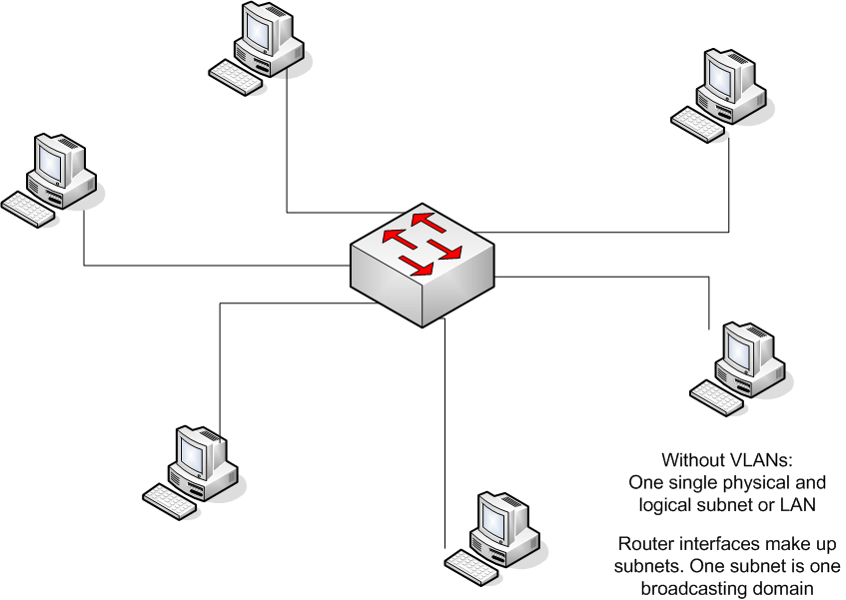
VLAN (Virtual LAN) and trunks (1/10)

Slide 47
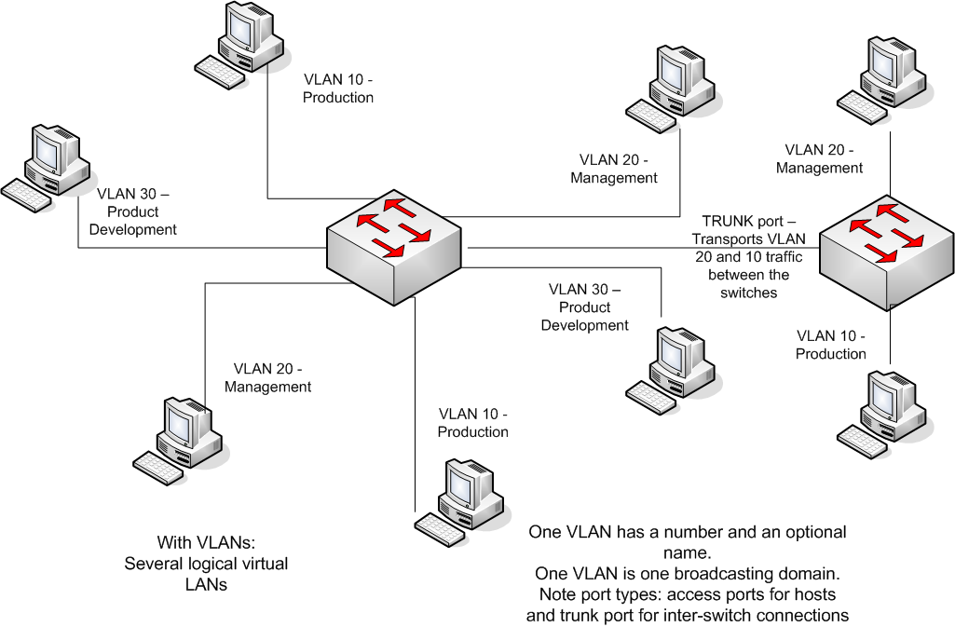
VLAN (Virtual LAN) and trunks (2/10)

Slide 48
VLAN (Virtual LAN) and trunks (3/10)
Without VLANs, you have LAN segments, that have all the hosts in the same logical group (subnet)
Without VLANs, you must connect a host based on its physical location
With VLANs, you can connect a host based on its logical group
I.e. Production, Finance, Product Development, Management, etc.
VLANs have a number and an optional name
By default, all the switch ports are access ports and belong to VLAN 1. Also, by default, all the inter-switch communication occur in VLAN 1 (VTP messages, Cisco Discovery Protocol = CDP etc.). You should change this after you have come up with your VLAN scheme
Connect all the managed switches into the same VLAN. That is, all the IP addresses of switches should belong to the same VLAN and subnet. Use i.e. VLAN 10 for management

Slide 49
VLAN (Virtual LAN) and trunks (4/10)
To route inter-VLAN traffic, a router is needed
Router-on-a-stick uses one router interface to route between VLANs (the switch port to connect to a router interface is configured as a trunk port)
  Compare this to an old-fashioned way, where as many router ports were required as there are VLANs
  Requires a support from a router
  A router is configured using sub-interfaces (one sub-interface per VLAN)
  Saves a lot of money (router interfaces are very expensive). So, use it
There is one special VLAN, called the native VLAN. In a trunk port if an untagged frame is received, it is automatically assumed to belong to the native VLAN. By default, the native VLAN is VLAN 1. Hence, all the untagged (native Ethernet) traffic is propagated into VLAN 1 ports
A native VLAN is born for example, when a hub with hosts on it is connected into the trunk connection between switches
Even if possible, you should not change the number of the native VLAN (1)
A native VLAN is dot1q concept

Slide 50
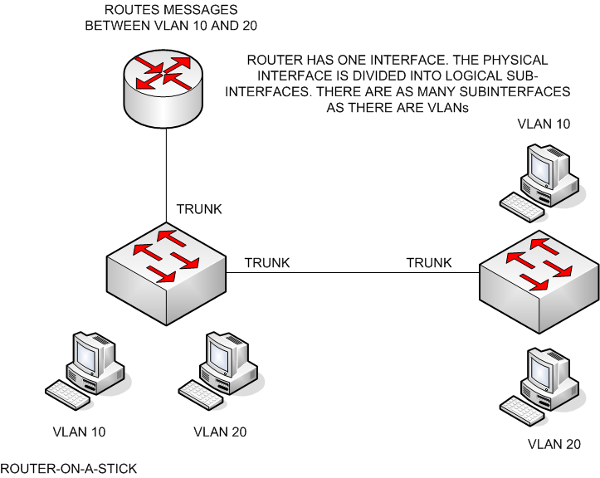
VLAN (Virtual LAN) and trunks (5/10)

Slide 51
VLAN (Virtual LAN) and trunks (6/10)
Local broadcast traffic, such as ARP is not propagated outside the VLAN
When the traffic is directed to outside a VLAN, the default IP gateway is used
Logically speaking, VLANs are also subnets. However, VLAN is an L2 concept, whereas a subnet is an L3 concept
A move of a user to a different location can be done provided that the old and new ports are connected to the same L2 network
Security and broadcast containment for a single VLAN. Inter-VLAN traffic can have ACLs
VLAN division can be logical, technical (i.e. VoIP in a single VLAN) , a security or a management issue (different QoS policies)

Slide 52
VLAN (Virtual LAN) and trunks (7/10)
VLAN membership can be:
  Static (fixed port configuration)
  Dynamic, that is plug-and-play (automatic membership based on i.e. a MAC-address, a user name or a group (i.e. read from AD)). Requires a membership policy server (VMPS). Viable in larger organizations but requires more advanced and expensive switch models (such as 6500)
  Voice (associated to VoIP phones)

Slide 53
VLAN (Virtual LAN) and trunks (8/10)
Access ports
  Port transports traffic belonging to a single VLAN
  A standard Ethernet NIC
  NIC does not need to understand any other traffic but IEEE 802.3 and Ethernet II frames
  MY_SWITCH(config)#int fast 0/1
  MY_SWITCH(config-if)#switchport mode access
  MY_SWITCH(config-if)#switchport access vlan 10
  MY_SWITCH(config-if)#exit
    OR a group of interfaces at a time:
  MY_SWITCH(config)#int range fast 0/1-9
  MY_SWITCH(config-if-range)#switchport mode access
  MY_SWITCH(config-if-range)#switchport access vlan 10
  MY_SWITCH(config-if-range)#exit

Slide 54
VLAN (Virtual LAN) and trunks (9/10)
Trunk ports
  A trunk port is capable of carrying traffic for multiple VLANs
  The original Ethernet frame must be modified to carry VLAN information
  Requires a special NIC (and more expensive one. I.e. a server NIC can be configured to a trunk hence allowing access from different VLANs)
  MY_SWITCH(config-if)#switchport mode trunk
  Cisco supports two trunking methods:
    ISL – Cisco proprietary
      Being phased out by Cisco
      MY_SWITCH(config-if)#switchport trunk encapsulation isl
    IEEE 802.1Q – known as dot1q
      The preferred method. Allows multiple vendors
      MY_SWITCH(config-if)#switchport trunk encapsulation dot1q
    Both ends must be configured to the same method
    You can also configure a negotiation
      MY_SWITCH(config-if)#switchport trunk encapsulation negotiate
    Encapsulation options depend on the switch model (2950 & 2960 support only dot1q). Be sure to buy interoperable switches!

Slide 55
VLAN (Virtual LAN) and trunks (10/10)
  Trunk port configuration for:
    Ports between switches
    Ports between switches and routers
    Server ports
  Trunk port can be configured to allow only certain VLANs
    MY_SWITCH(config-if)#switchport mode trunk
    MY_SWITCH(config-if)#switchport trunk allowed vlan add 1,10,20
    It is easy to forget some VLANs from a trunk, so to make an administrators task easier, allow all:
    MY_SWITCH(config-if)#switchport trunk allowed vlan all
    If you allow all VLANs in a trunk, be sure to use VTP pruning
    MY_SWITCH(config)#vtp pruning

Slide 56
VLAN Trunk protocol – VTP (1/4)
Cisco proprietary protocol to share VLAN info between Cisco switches (more specifically, between switch trunk ports)
Removes much of the manual configuration of switches
Compare two networks: first with 2 switches and second with 30 switches
  You definitely need VTP, at least in larger networks
Works only with switches, routers do not propagate VTP messages from one interface to another
VTP domain
  The VTP domain has identical info in all switches belonging to the domain
  Compare to the Autonomous System in routing

Slide 57
VLAN Trunk protocol – VTP (2/4)
Switch can be in one of the modes:
  Client
  Server
  Transparent
A trick that is sometimes used, is to hook up a new switch into the network in the client mode. Wait for it to receive VTP data and then configure it to a server. You need to configure, however, the VTP domain before that

Slide 58
VLAN Trunk protocol – VTP (3/4)
 |  |  |  | Server | Client | Transparent
Can add, modify and delete VLANs |  |  |  | Yes | No | Yes
Can generate VTP messages |  |  |  | Yes | No | No
Can propagate VTP messages |  |  |  | Yes | Yes | Yes
Can accept changes in a VTP message |  |  |  | Yes | Yes | No
Default VTP mode |  |  |  | Yes | No | No
Saves VLANs to NVRAM |  |  |  | Yes | No | Yes

Slide 59
VLAN Trunk protocol – VTP (4/4)
One option would be to configure one central switch to a server and all the rest to clients
Worst-case scenario: You have a VLAN with 500 hosts and you happen to delete that VLAN in the server => All the switches drop this VLAN information
Also, you can configure all or some of your switches to servers
If you don’t configure anything, the default mode is server
To keep track of changes, the configuration revision number is incremented each time upon a change and an advertisement is made to other switches
The highest configuration revision number is always the latest configuration. This revision is used and the other configurations get deleted
VLAN database is saved in vlan.dat file, NOT in startup-config. ”erase startup-config” does NOT delete vlan.dat. Hence, the worst-case scenario here is that when you boot up an erased switch into an existing network, it may have a higher config rev number (in vlan.dat) and overwrites the existing VLAN info
  To be on a safe side, delete vlan.dat of a switch before connecting it to your network
  MY_SWITCH#delete vlan.dat

Slide 60
VTP Pruning (1/4)
By default, any broadcast, multicast or an unknown unicast traffic is flooded out all ports associated the source VLAN, including trunks
Flooding takes place into other switches, even if there are no active ports in them, as long as the trunk port has a source VLAN associated to it or all VLANs are associated to a trunk
Think of a video multicast stream of 5 Mbps flooding everywhere
Traffic rate can be downscaled by allowing manually only active VLANs in trunks but this is tedious. This is called static VLAN pruning. A better option would be using VTP Pruning and allowing all VLANs in trunk ports. This is called dynamic VLAN pruning

Slide 61
VTP Pruning (2/4)
In order it to work, VTP pruning needs to be enabled only on one VTP server switch per VTP domain. All the switches involved in pruning are either VTP clients or VTP servers
Transparent VTP switches must be pruned manually
VTP pruning increases your network’s efficiency, especially in larger networks, so you want to definitely enable it

Slide 62
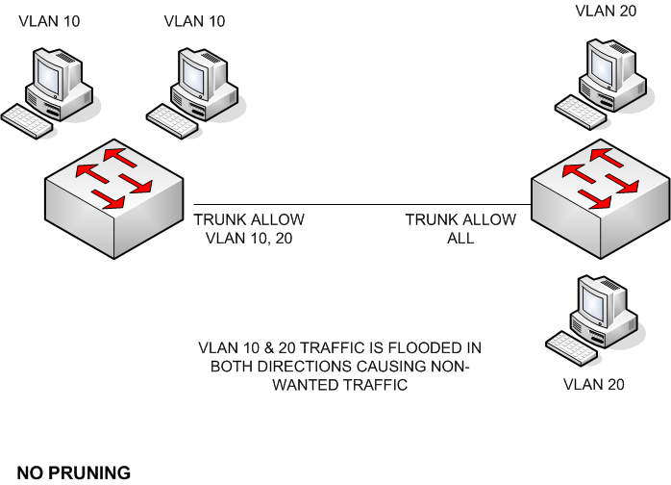
VTP Pruning (3/4)

Slide 63
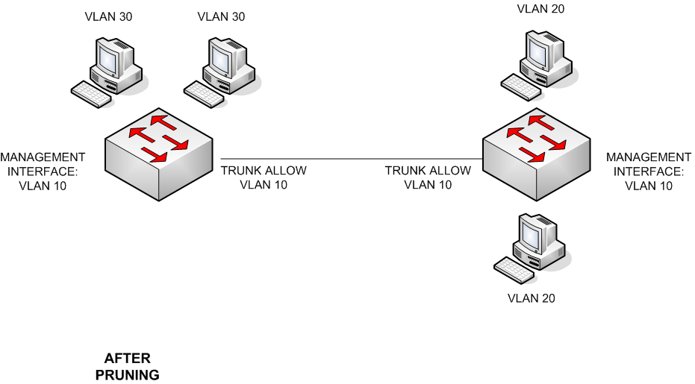
VTP Pruning (4/4)

Slide 64
VTP configuration (1/2)
VTP Component |  | 2960
Domain name |  | None
Mode |  | Server
Password |  | None
Pruning |  | Disabled
Version |  | 1
VTP Default values

Slide 65
VTP configuration (2/2)
2960(config)#vtp domain MyDomain
2960(config)#vtp mode server|client|transparent
2960(config)#vtp password cisco
2960(config)#vtp pruning
2960#show vtp status
VTP Version : 2
Configuration Revision : 1
Maximum VLANs supported locally : 64
Number of existing VLANs : 5
VTP Operating Mode : Server
VTP Domain Name :
VTP Pruning Mode : Disabled
VTP V2 Mode : Disabled
VTP Traps Generation : Disabled
MD5 digest : 0x70 0x01 0xF2 0x72 0x97 0xA1 0x35 0xEB
Configuration last modified by: 0.0.0.0 at 11-29-93 20:39:24
Local updater ID is 0.0.0.0 on interface Vl1 (lowest numbered VLAN interface
found)
2960#
Obs! These commands do not work properly with the simulator!

Slide 66
Dynamic Trunk Protocol – DTP (1/3)
Proprietary Cisco protocol, which dynamically forms and verifies trunk connections between switches
Works only in some switch models
If you can cope with ”switchport mode trunk” command – that is, statically define some ports to trunk, stick to it, because of its simplicity
DTP has 5 modes

Slide 67
DTP (2/3)
DTP Mode |  | Generate DTP Messages |  |  | Default Frame Tagging
On or trunk |  | Yes |  |  | Yes
Desirable |  | Yes |  |  | No
Auto |  | No |  |  | No
Off |  | No |  |  | No
No-negotiate |  | No |  |  | Yes
On or Trunk – The connection is always assumed to be trunk.
The same behavior as: SWITCH(config-if)#switchport mode trunk
Desirable – The connection starts as an access link. If the remote end
sends a DTP message and this is compatible, the trunk connection is
formed
Auto – The same as Desirable, but does not send DTP messages. The
connection starts as an access link. If the remote end sends a DTP message
and this is compatible, the trunk connection is formed
No-negotiate – The interface is configured as a trunk connection, but DTP
messages are not generated. This is used to connect with non-Cisco devices
No – The interface is configured as an access-link
Switch#sh interfaces trunk

Slide 68
DTP (3/3)
Your switch |  | Remote Switch
On |  | On, desirable, auto
Desirable |  | On, desirable, auto
Auto |  | On, desirable
No-negotiate |  | No-negotiate
The port configurations in order that the trunk connection is formed.
Switch(config-if)#switchport mode trunk
Switch(config-if)#switchport mode dynamic auto
Switch(config-if)#switchport mode dynamic desirable
Switch(config-if)#switchport nonegotiate
Switch(config-if)#no switchport mode trunk

Slide 69
VLAN creation (1/2)
# of VLANs depend on the switch type
Some VLANs are pre-configured in each switch:
  VLAN 1 (native VLAN)
  VLAN 1002-1005 – Token Ring and FDDI networks
  To add or delete VLANs, you must be in a server mode (or in a transparent mode)
  All the switch ports belong to VLAN 1 and are access ports by default. You should change this after your VLAN scheme
  CDP, DTP and VTP are sent in VLAN 1
  Before deleting a VLAN, reassign all the ports associated to a different VLAN

Slide 70
VLAN creation (2/2)
Access ports:
  Switch(config)#int fast 0/1
  Switch(config-id)#switchport mode access
  Switch(config-id)#switchport access vlan VLAN#
  Switch(config-id)#exit
VLAN creation (must be in a server mode (or transparent)):
  Switch#vlan VLAN#
  Switch(vlan)#name Production
  Switch(vlan)#exit
To verify the VLANs, type:
  Switch#sh vlan
  Switch#sh int fast 0/1 switchport
If you see a line Access Mode VLAN: n (inactive), you have probably deleted a VLAN n
Switch#sh int trunk
Switch#sh vtp

Slide 71
Router-on-a-stick
Router-on-a-stick is an L2/L3 configuration, where only one physical router interface is needed for inter-VLAN routing
Router:
  The physical interface of a router that is connected to a switch, is configured with no IP address (i.e. f0/0). In addition, the router’s physical interface must be turned on with ”no shut”
  Duplexing and speed are done on the physical interface, most other configs are done for a logical (subinterface) interface
  Subinterfaces of a router are used to configure the settings for each VLAN, that is, the encapsulation mode (ISL or dot1q) and the IP address with a mask
  The mask of an IP address is typed using dotted decimal notation i.e. 255.255.255.128. No CIDR notation is available with Cisco IOS (i.e. 192.168.1.1/24 is not allowed)
  Use the subinterface numbers consistently:
    VLAN 1 in the subinterface f0/0.1
    VLAN 20 in the subinterface f0/0.20 etc.
Switch:
  VLANs used are added. VLAN 1 needs not to be added, because it exists by default
  The switch port to connect to the router is configured as a trunk port
  The switch ports to connect to hosts are configured to access ports
  The management VLAN of the switch is configured and turned on with ”no shut”
The hosts should be able to ping hosts in another VLANs. The traffic is routed through the router

Slide 72
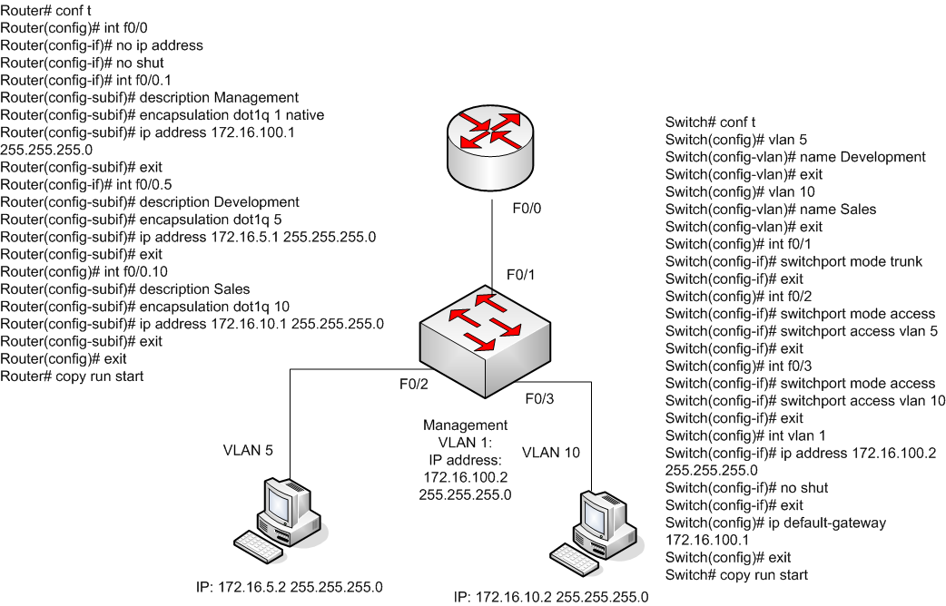
Router-on-a-stick
Native command does not work in a simulator
This is the VLAN id number
For consistency and ease of debugging,
use the same subinterface number as VLAN id

Slide 73
L2 redundancy
Redundancy is implemented in different levels in larger networks
  Several WAN links
  L3 multipath and load-balance
  L2 redundancy (Spanning Tree Protocol – STP, EtherChannels)
Because of redundancy in L2, loops are created which can cause:
  Multiple frame copies
  Broadcast storms – remember, ARP uses local broadcast
  Mislearning MAC addresses
An efficient algorithm to prevent the loops is required
  STP – Spanning tree protocol
  Specifics are not included in this lab course
  If you are interested, check:
  http://en.wikipedia.org/wiki/Spanning_Tree_Protocol
  Or better yet, check one of the course books

Slide 74
Private IP address spaces (inside NAT)
Class A: 10.0.0.0 – 10.255.255.255
Class B: 172.16.0.0 – 172.31.255.255
Class C: 192.168.0.0 – 192.168.255.255
The easiest to manage and remember is the 10.*.*.* address space, since it is the largest and simplest. That is why many organizations rely on this address space
Even with IPv6 the private IP addresses will stick around

Slide 75
Routing basics (1/4)
A router learns new routes either statically or dynamically
Static route is learnt:
  From directly connected interfaces
  Manually configured (static) routes
  A default route is used as a last resort
    Common configuration in stub networks pointing to ISP router
    IP address: 0.0.0.0
    Subnet mask: 0.0.0.0
Dynamic route is learnt by using a routing protocol:
  RIPv1, RIPv2, IGRP+EIGRP (Cisco proprietary), OSPF, BGP, IS-IS
Typically, a static routing or RIPv2 is used in simple and small networks. If your company policy is 100% Cisco, your choice of routing protocol could be EIGRP. If you are running a multivendor system, use OSPF or IS-IS
Autonomous System is a group of routers under the same administration. AS’s are numbered
The routing protocols that understand AS are: EIGRP, OSPF, IS-IS and BGP. RIP does not
A routing protocol within the AS is called IGP (Interior Gateway Protocol). EGP (Exterior Gateway Protocol) routes inter-AS traffic (BGP)

Slide 76
Routing basics (2/4)
Cisco routers looks at two things when choosing the best route: Administrative Distance (AD) and routing metrics
AD is a Cisco proprietary concept. A smaller AD number is preferable among multiple route informations. Obs! The same router can simultaneously run several routing protocols and can have static routes as well
You can think of AD as how reliably the routing information was obtained
If there are two or more routes to the same destination learnt from the same routing protocol, the routing metrics is used to pick up the best route. If also the routing metrics are the same, routing protocols use load-balancing (round robin)
A routing metric can be: bandwidth, cost, delay, hop count, load, MTU or reliability depending on the routing protocol
With point-to-point links, such as serial lines, a subnet consumes only 2 hosts. You would use a subnet mask 255.255.255.252 with p2p links, which gives a block size 4 and the number of hosts 2 (the first address is the network itself and the last address in the block is a local broadcast address)

Slide 77
Routing basics (3/4)
Administrative distance |  |  |  | Route type
0 |  |  |  | Connected interface route
0 or 1 |  |  |  | Static route
90 |  |  |  | Internal EIGRP route (within the same AS)
110 |  |  |  | OSPF route
120 |  |  |  | RIPv1 and v2 route
170 |  |  |  | External EIGRP (from another AS)
255 |  |  |  | Unknown route (considered an invalid route)
If there are several learnt routes from different routing protocols, the Cisco router favors the route with the smallest AD

Slide 78
Routing basics (4/4)
Three types of routing protocols:
  Distance vector
  Link state
  Hybrid

Slide 79
Distance vector protocols (1/3)
  To find the path, the distance and direction are used
  Bellman-Ford algorithm
  Local and periodic broadcast messages
    The complete routing table is broadcast to neighbors
  RIP, IGRP

Slide 80
Distance vector protocols (2/3)
When a router receives a routing update from a neighbor, the following steps are performed (Bellman-Ford algorithm):
  Increment the metrics of the incoming routes. With RIP, this is a hop count
  Compare the network numbers
  If the advertised information from the neighbor is better, place to route to the routing table and remove the old entry
  If the advertised info is worse, ignore it
  If the advertised info already exists the same in the routing table, reset the entry timer
  If the advertised info has a different path and an equal metric as the old route information, both the routes are kept in the routing table. Some routing protocols support load balancing for equal-cost paths

Slide 81
Distance vector protocols (3/3)
Disadvantages
  Slow convergence time
  Heavy network traffic
  Routing loops may occur:
    Split Horizon: Do not send the routing information back to the same direction you got it in the first place
    Route poisoning: Advertise the failed link as unreachable (16 in RIP)
    Holddown timers: Start a timer when the link goes up or down. The change is effective only after the timer has expired. This is especially useful with serial links, that might go up and down and up again (this is called flapping)
Advantages
  Easy to configure and debug
  A low overhead for processing

Slide 82
Link state protocols (1/3)
LSPs employ the Shortest Path First algorithm (SPF) invented by E.W. Dijkstra
The whole network topology is stored in routers. This can lead to scalability problems with large networks
The LSP routers create three separate tables:
  Directly attached neighbors
  Topology of the entire nw
  Routing table
OSPF and IS-IS
OSPF is harder to setup and debug than RIP or EIGRP and IS-IS is even harder than OSPF

Slide 83
Link state protocols (2/3)
LSPs use multicast to disseminate the nw information
LSAs (Link State Advertisement) are multicast typically only in the event of topology changes
LSAs are sent reliably. An acknowledgement is sent after receiving an LSA update
Any time a change occurs, the routers run the SPF for their local topology table

Slide 84
Link state protocols (3/3)
Advantages:
  With the LSPs a hierarchical structure is employed. Hence, the changes in the nw do not necessarily propagate to all the routers. I.e. OSPF contain the propagations in areas
  Multicast (vs. broadcast in distance vector protocols) reduces the overall processing and nw bandwidth
  Typically in the boot-up the routers learn the nw topology and after that only the updates are sent out making this a more efficient protocol than distance vector protocols
  LSPs support classless routing which allows you to use route summarization. A large group of contiguous routes can be summarized into smaller number of routes (VLSM, CIDR)
  With route summarization and hierarchical routing, LSPs scale to larger nw sizes
Disadvantages:
  LSPs are CPU- and memory-intensive protocols
  Running the SPF requires a lot more processing than incrementing and comparing the metrics of incoming routes with distance vector protocols

Slide 85
Hybrid protocols
Typically, hybric protocols combine features from both the distance vector protocol and link state protocol
EIGRP, BGP
The most common IGP protocol today is OSPF followed by EIGRP. In SOHO networks, the static routes are the most typical implementation

Slide 86
Static routes (1/4)
A static route is a manually configured route in your router
A typical way to handle routes in small networks
Not a viable way in medium to large networks or when you have many subnets in your nw

Slide 87
Static routes (2/4)
Static route configuration:
  Router(config)#ip route DESTINATION_NW [subnet_mask] IP_ADDRESS_OF_NEXT_HOP_NEIGHBOR [administrative distance] [permanent]
  OR
  Router(config)#ip route DESTINATION_NW [subnet_mask] EXIT_INTERFACE [administrative_distance] [permanent]
  The first parameter is the destination network number followed by a subnet mask. If the subnet mask is left out, the router uses default masks depending on the destination nw. A nw – 255.0.0.0, B nw – 255.255.0.0, C nw – 255.255.255.0
  You can configure the next hop address by the IP address or by the exit interface
    If the outgoing link is a multi-access link, use the IP address. The default AD will be 1
    If the outgoing link is i.e. a point-to-point link, you can use the next hop interface. The default AD will be 0
  Router(config)#ip route 172.16.10.1 255.255.255.0 10.0.1.1
  Router(config)#ip route 172.16.10.1 255.255.255.0 serial0
  Remember the administrative distance from a previously shown slide. If you are going to use both the static addresses and dynamic routing in parallel, you could set the AD of static routes to 200, which is greater than the AD of any routing protocol. The static routes would become backup routes in case the dynamic routing fails. If you have redundancy in your networks, you could set the AD of secondary static routes to 201 etc.
  Administrative distance is not supported by the simulator

Slide 88
Static routes (3/4)
Static route configuration (cont.):
  By default, the next hop address as an IP address has an administrative distance of 1 and the next hop address as an outgoing interface has an administrative distance of 0
    You can change the default values with the administrative distance parameter
  You can create multiple static routes to the same destination. You need this when you use a primary route and a secondary route. If the primary route fails, the secondary route is used. Then you must use a different administrative distance value, i.e. a default value for the primary route and the value 2 for the secondary router
  If you omit the permanent parameter, the router drops the route from its memory in case the link goes down. You might want to use the permanent parameter if you never want the packets to follow a specific route, perhaps due to security reasons

Slide 89
Static routes (4/4)
A default route can be configured to enable the last resort. If the router does not know the destination, it propagates the packets to the default route
The default route is typically used in stub networks with only one exit path
Router(config)#ip route 0.0.0.0 0.0.0.0 IP_ADDRESS_OF_NEXT_HOP_NEIGHBOR [administrative_distance] [permanent]
OR
Router(config)#ip route 0.0.0.0 0.0.0.0 INTERFACE_TO_EXIT [administrative_distance] [permanent]
The network 0.0.0.0 represents all the networks and the mask 0.0.0.0 represents all the hosts in the specified network
If you use the defaut route, you must also give a specific command:
  Router(config)#ip classless
You can also apply the default network:
  Router(config)#ip default-network 192.168.1.0
To verify the static and default routes:
  Router#sh ip route
  Output: C – connected, S – static, * - default route

Slide 90
Classful and classless routing protocols
Classful protocols:
  RIPv1, IGRP (no longer supported by Cisco)
Classless protocols:
  RIPv2, OSPF, EIGRP, IS-IS, BGP
When a classful router advertises a route, it does not contain the subnet mask. You can only use one subnet mask for all the devices in the network (VLSM is not applicable)
A classless router advertises the subnet mask, too, making it possible to use VLSM and route-summarization

Slide 91
RIP (1/2)
Maximum hop count is 15 making this protocol suitable only for small networks. The hop count 16 means unreachable
RIP sends the complete routing table to all active interfaces every 30 seconds
Works well in small networks
RIPv1 and RIPv2 differences:
  RIPv1 is classful, whereas RIPv2 is classless
  RIPv1 uses broadcast, whereas RIPv2 uses multicast
  Only RIPv2 supports VLSM
  Authentication is an option with RIPv2
  RIPv2 supports discontiguous networks (see http://answers.yahoo.com/question/index?qid=20080722132707AAn9sit)
To configure RIP, just turn on the protocol with ”router rip” command and tell the RIP all the networks that are advertised with ”network” command. Typically, you want to advertise all the directly connected networks. To enable RIPv2, use the ”version 2” command
  Router(config)#router rip
  Router(config-router)#version 2|1
  Router(config-router)#network A.B.C.D
  Router(config-router)#exit
RIPv1 and RIPv2 are configured as classful, meaning that only the base class network is typed. For example, if you have the subnets 172.16.1.0 and 172.16.2.0 you only configure one classful network 172.16.0.0. The RIPv2 router finds the subnets and the masks from the interface settings. With 10.0.1.0 and 10.0.2.0 you would supply the network 10.0.0.0 only
You can turn off sending RIP updates out to the interface. You might want to do this with the interfaces, that have no routers on the other end
  Router(config-router)#passive-interface s0/0/0
To disable the auto-summary:
  Router(config-router)#no auto-summary

Slide 92
RIP (2/2)
RIP uses 4 timers to adjust its performance
  Route update timer: The interval between periodic routing updates (typically 30s)
  Route invalid timer: The time that elapses before the route is considered invalid (typically 180s)
  Hold-down timer: The time during which the routing information is suppressed. Routers enter into the holddown state when an update packet is received indicating that the route is unreachable
  Router flush timer: The time between a route comes invalid and its dropping from the routing table (typically 240s). Must be greater than route invalid timer
Router(config-router)#timers basic 30 90 180 270 360
  30 = Update timer
  90 = Invalid timer
  180 = Hold-down timer
  270 = Flush timer
  360 = Sleep time

Slide 93
ACL (1/24)
Access Control Lists
Creating, updating and debugging ACL can be pretty cumbersome
Cisco ACL supports in addition to IP also IPX, AppleTalk and others
Filters traffic upon either leaving (outbound) or entering (inbound) the interface
For inbound ACL, the ACL is processed before any further processing by IOS. With the outbound ACL, the packet is first routed to the interface and then the outbound ACL is processed
ACL applied to outbound cannot filter traffic that originates from the IOS itself
Applied to:
  Remote access (Telnet, SSH)
  Routing info
  Traffic prioritizing with queues
  DDR triggering (Dial-on-demand)
  IPSec VPN
  And many others

Slide 94
ACL (2/24)
ACL commands either permit or deny traffic
Types of ACL:
  #1 numbered and named
  #2 standard and extended
    Standard IP ACLs filter on the source IP address inside a packet
    Extended IP ACLs filter on the source and destination IP address in the packet, the protocol (TCP, UDP, ICMP and so on) and protocol info (such as TCP or UDP port numbers or ICMP message type)

Slide 95
ACL (3/24)
Filtered Information |  |  | Standard IP ACL |  | Extended IP ACL
Source address |  |  | Yes |  | Yes
Destination address |  |  | No |  | Yes
Protocol (TCP, UDP etc.) |  |  | No |  | Yes
Protocol information (i.e. port number) |  |  | No |  | Yes

Slide 96
ACL (4/24)
ACL is a list of statements that are linked together with a name or a number
ACL is processed top-down. A packet is compared with one statement at a time (permit or deny). A new entry is added to the bottom of the list
You should always put the most restricting statements in the top of the list and the least restricting to the bottom of the list
The following order is applied with ACLs:
  #1 Once a match (permit or deny) is found, no further statements are processed
  #2 The order of the statements is important, because once a match is found, the rest of the statements are ignored
  #3 If no match is found in the list, the packet is dropped (implicit deny)
ACL should include at least one permit statement, otherwise it is always dropped
Only one IP ACL can be applied to an interface in each direction (inbound and outbound)
If you apply an empty ACL to an interface, it permits all the traffic (implicit deny requires at least one permit or deny statement). But you should never use empty ACLs
You cannot remove one line from an access list. Trying this will result in the removal of the entire list
Place IP standard access lists as close to the destination as possible
Place IP extended access lists as close to the source as possíble

Slide 97
ACL (5/24)
To create a numbered ACL:
  Router(config)#access-list ACL# permit|deny conditions
  You can only use a prespecified ACL number as follows:
  On the other hand, you can use named ACLs as much as you have memory in your router
To apply the ACL into the interface, you must activate it:
  Router(config)#int type [slot#]/port#
  Router(config-if)#ip access-group ACL# in|out
You can apply ACL also into the subinterfaces, i.e. f0/0.1
ACL Type |  | ACL Numbers
IP Standard |  | 1-99, 1300-1999
IP Extended |  | 100-199, 2000-2699

Slide 98
ACL (6/24)
Instead of typing all the possible IP addresses, you can apply wildcard masks to match a range of addresses
Do not confuse with subnet masks!
A wildcard mask is 32 bits long as is the subnet but the bits are interpreted differently

Slide 99
ACL (7/24)
Bit Value | Subnet mask |  | Wildcard Mask
0 | Host component |  | Must match
1 | Network component |  | Ignore
Wildcards:
0 in a bit position means that the corresponding bit in the address
of the ACL statement must match the same bit in the IP address of
the examined packet
1 in a bit position means that the corresponding bit in the address
of the ACL statement does not have to match the same bit in the IP
address of the examined packet

Slide 100
ACL (8/24)
A wildcard mask is actually an inverted subnet mask
An example: a subnet mask 255.255.0.0
  In a binary format this is: 11111111.11111111.00000000.00000000
  And the mask after inverting is: 00000000.00000000.11111111.11111111
  Which is: 0.0.255.255
  This wildcard mask means that the first 16 bits of the IP address of the packet must match with the 16 first bits of the ACL statement
  Inverting bytes 0 and 255 is easy. 0 becomes 255 and 255 becomes 0
  An easy way to invert a byte from a subnet mask to a wildcard is to subtract the corresponding byte from 255. What becomes of the subnet mask 255.255.240.0?
    A: 255-255=0
    B: 255-255=0
    C: 255-240=15
    D: 255-0=255
    255.255.240.0 -> 0.0.15.255
  You can use an online tool for this:
    http://www.subnet-calculator.com/
Two special case wildcards: 0.0.0.0 and 255.255.255.255
  0.0.0.0 means that all the 32 bits of the address in the ACL statement must match the IP address of an examined packet. This mask is called a host mask. IOS converts this mask to ”host”
  172.16.1.2 0.0.0.0 means that the address must be exactly 172.16.1.2. Alternatively, you can type: ”host 172.16.1.2”
  0.0.0.0 255.255.255.255 means any address will do. IOS converts this mask to ”any”. Alternatively, you can type: ”any”

Slide 101
ACL (9/24)
Examples:
IP Address |  | Wildcard Mask |  | Matches
0.0.0.0 |  | 255.255.255.255 |  | Matches with any address
10.0.1.1 |  | 0.0.0.0 |  | Matches only when the address is 10.0.1.1
10.0.1.0 |  | 0.0.0.255 |  | Matches when the address matches the subnet 10.0.1.0/24
 |  |  |  | 10.0.1.0-10.0.1.255
10.0.2.0 |  | 0.0.1.255 |  | Matches when the address matches the subnet 10.0.2.0/23
 |  |  |  | 10.0.2.0-10.0.3.255
10.1.0.0 |  | 0.0.255.255 |  | Matches when the address matches the subnet 10.1.0.0/16
 |  |  |  | 10.1.0.0-10.1.255.255

Slide 102
ACL (10/24)
Standard numbered ACLs:
  Router(config)#access-list 1-99|1300-1999 permit|deny source_IP_address [wildcard mask] [log]
  The condition is based only on the source IP address
  If you omit the wildcard mask, it defaults to 0.0.0.0 requiring an exact match. Obs! The simulator behaves differently. You need to type a mask (be it 0.0.0.0) or type: ”host IP_address”
  You can use as a source IP-address a parameter ”host IP_address” (same as IP_address 0.0.0.0) or ”any” (same as 0.0.0.0 255.255.255.255)
  log causes the match to be printed on the console port
Example:
  Router(config)#access-list 10 deny host 10.0.1.2 – OR - Router(config)#access-list 10 deny 10.0.1.2 0.0.0.0
  Router(config)#access-list 10 permit any
  Router(config)#int serial 0
  Router(config-if)#ip access-group 10 in
The access-list 10 is processed as follows:
  The access-list is applied to the inbound traffic of serial line 0
  First, deny the traffic, if the source IP address is 10.0.1.2
  If the source IP address was not 10.0.1.2, permit all the traffic
Example:
  Router(config)#access-list 20 deny 10.0.1.0 0.0.0.255
  Router(config)#access-list 20 permit any
  Router(config)#int serial 1
  Router(config-if)#ip access-group 20 out
The access-list 20 is processed as follows:
  The access-list is applied to the outbound traffic of the serial line 1
  First, deny the traffic from the subnet 10.0.1.0/24 or 10.0.1.0-10.0.1.255
  If the source address was not 10.0.1.0/24, allow all the traffic

Slide 103
ACL (11/24)
You definitely want to restrict the VTY access (Telnet, SSH) to your router
You apply the ACL to the VTYs, not the router interfaces as follows:
  Router(config)#access-list 20 permit 192.168.1.0 0.0.0.255
  Router(config)#line vty 0 4
  Router(config-line)#access-class 20 in
This ACL allows the VTY only from the subnet 192.168.1.0/24
To secure VTY, you need to apply a login and a password plus a standard ACL allowing the traffic only from the management stations
Telnet is clear-text and IP addresses can be spoofed. So, better to use SSH

Slide 104
ACL (12/24)
Extended ACL can match on the following info:
  Source and destination IP address
  TCP/IP protocol (IP, TCP, UDP, ICMP etc)
  Protocol info, such as port numbers or message types

Slide 105
ACL (13/24)
Router(config)#access-list 100-199|2000-2699 permit|deny IP_protocol source_address source_wildcard_mask [protocol_information] destination_address destination_wildcard_mask [protocol_information] [log]
The most typical IP_protocol values are: ip, icmp, tcp, gre, udp, igrp, eigrp, igmp, ipinip, nos and ospf
  If you want to match on any IP protocol, use the keyword ip
  If you want to filter by application layer protocol, you have to choose the appropriate layer 4 transport protocol. For example, to filter ftp you choose TCP
  You can use ”host IP_address” (same as IP_address 0.0.0.0) or ”any” (same as 0.0.0.0 255.255.255.255) parameters for both source and destination
You must specify both the source and destination addresses and their wildcard masks
Log has the same meaning as with a standard ACL
After creating the ACL, you must activate it to the router’s interface with ”ip access-group” command, same as the standard ACL

Slide 106
ACL (14/24)
To configure ACL for TCP or UCP use the following:
  Router(config)#access-list 100-199|2000-2699 permit|deny tcp|udp source_address source_wildcard_mask [operator source_port_#] destination_address destination_wildcard_mask [operator destination_port_#] [established[ [log]
  With TCP and UDP you can specify the port numbers or names of the source, destination or both
    You specify an operator to define how to make a match with numbers of names
    TCP and UDP operators are as follows:
      lt - less than
      gt - greater than
      neq - not equal to
      eq - equal to
      range - range of port numbers

Slide 107
ACL (15/24)
With TCP and UDP connections, you list either a name or a number of the port
  i.e. tfpt – 69, ssh - 22
The names and numbers can be found:
  http://www.iana.org/assignments/port-numbers
The established keyword is used only with TCP
  TCP traffic that originates from your network and is connected to outside
  With established keyword you either deny or allow returning TCP traffic, that has a certain flag set in the TCP segment

Slide 108
ACL (16/24)
With ICMP you use:
Router(config)#access-list 100-199|2000-2699 permit|deny icmp source_address source_wildcard_mask destination_address destination_wildcard_mask [icmp_message] [log]
ICMP does not use ports, only messages (it is L3 protocol)
Omitting the ICMP message type, all message types are included
The most common ICMP messages are:
  echo - used by ping
  echo-reply - reply to ping
  host-unreachable - subnet is reachable, but the host is not responding
  net-unreachable - network/subnet is not reachable

Slide 109
ACL (17/24)
To remove ACL from an interface:
  Router(config)#int serial 0
  Router(config-if)#no ip access-group ACL_#
ACL is deleted by:
  Router(config)#no access-list ACL_#
To view the ACLs:
  Router#sh access-lists
To view a specific ACL number:
  Router#sh access-lists 100
To view the interfaces, that have ACLs hooked:
  Router#sh ip interface
To view the ACLs and the interfaces:
  Router#sh run

Slide 110
ACL (18/24)
Extended ACL examples:
Router(config)#access-list 100 permit udp any host 10.0.1.2 eq dns log
Router(config)#access-list 100 permit tcp 10.0.0.0 0.0.255.255 host 10.0.1.3 eq telnet log
Router(config)#access-list 100 permit icmp any 10.0.0.0 0.0.255.255 echo-reply log
Router(config)#access-list 100 deny ip any any log
Router(config)#int ethernet 0
Router(config-if)#ip access-group 100 in
The ACL filters the inbound traffic of the ethernet 0 interface. This ACL permits DNS for the host 10.0.1.2 from any host, permits the telnet traffic to the host 10.0.1.3 from the 10.0.*.* address space, permits echo-reply from any host to the subnet 10.0.0.0/16 and denies all the rest of the traffic
”Router(config)#access-list 100 deny ip any any log” could be left off, but this line forces all the dropped traffic to be printed on the console port (which implicit deny does not do)

Slide 111
ACL (19/24)
Example:
Router(config)#access-list 110 deny tcp any host 10.0.1.2 eq 23 log
The ACL 110 denies telnet traffic from any host that have a destination 10.0.1.2. The matches are printed on the console port
Router(config)#access-list 120 deny tcp any 172.16.1.0 0.0.0.255 eq 23
Router(config)#access-list 120 deny tcp any 172.16.2.0 0.0.0.255 eq 23
Router(config)#access-list 120 permit ip any any
Router(config)#int f0/0
Router(config-if)#ip access-group 120 out
Router(config-if)#exit
Router(config)#int f0/1
Router(config-if)#ip access-group 120 out
The ACL 120 is applied to two fastethernet interfaces, outbound traffic. Telnet is denied from any host to the subnet 172.16.1.0/24 and 172.16.2.0/24. All the rest of the traffic is allowed

Slide 112
ACL (20/24)
Named ACLs
You can delete a single entry in a named ACL without deleting the whole ACL
Router(config)#ip access-list standard|extended ACL_name
This command takes you into a subconfiguration mode:
Router(config-std-acl)# - OR – Router(config-ext-acl)#
With a standard ACL, use:
  Router(config)#ip access-list standard ACL_name
  Router(config-std-acl)#permit|deny source_IP_address [wildcard_mask]
With an extended ACL, use:
  Router(config)#ip access-list extended ACL_name
  Router(config-ext-acl)#permit|deny IP_protocol source_IP_address wildcard_mask [protocol_information] destination_IP_address wildcard_mask [protocol_information] [log]

Slide 113
ACL (21/24)
You can insert comments to your ACLs:
  With a numbered ACL:
    Router(config)#access-list ACL_# remark Your_remark
  With a named ACL:
    Router(config)#ip access-list standard|extended ACL_name
    Router(config-{std|ext}-acl)#remark Your_remark

Slide 114
ACL (22/24)
Starting from IOS 12.3 you can edit individual entry lines in your ACL. This is called a sequenced ACL
With the sequenced ACL, each ACL command is given a sequence number starting from 10 and having an increment of 10
You can view the sequense numbers by:
  Router#sh access-list

Slide 115
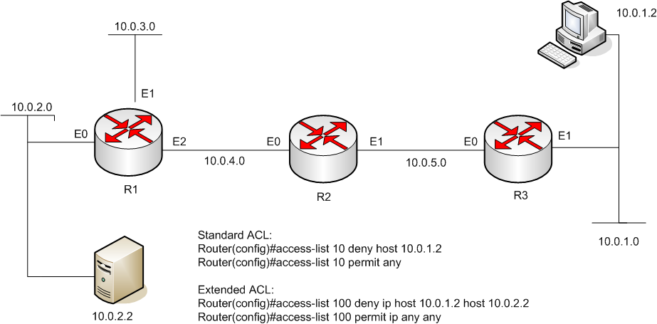
ACL (23/24)
There are two rules about placement of standard
and extended ACLs in your network:
#1 Standard ACLs should be placed as close to the destination as possible
#2 Extended ACLs should be placed as close to the source as possible
You want to deny the access from the host 10.0.1.2 to the server 10.0.2.2.
Q: Now, where would you place these two ACLs in the network?

Slide 116
ACL (24/24)
The standard ACL goes to the E0 out interface of R1.
The extended ACL goes to the E1 in interface of R3.
Why?

Slide 117
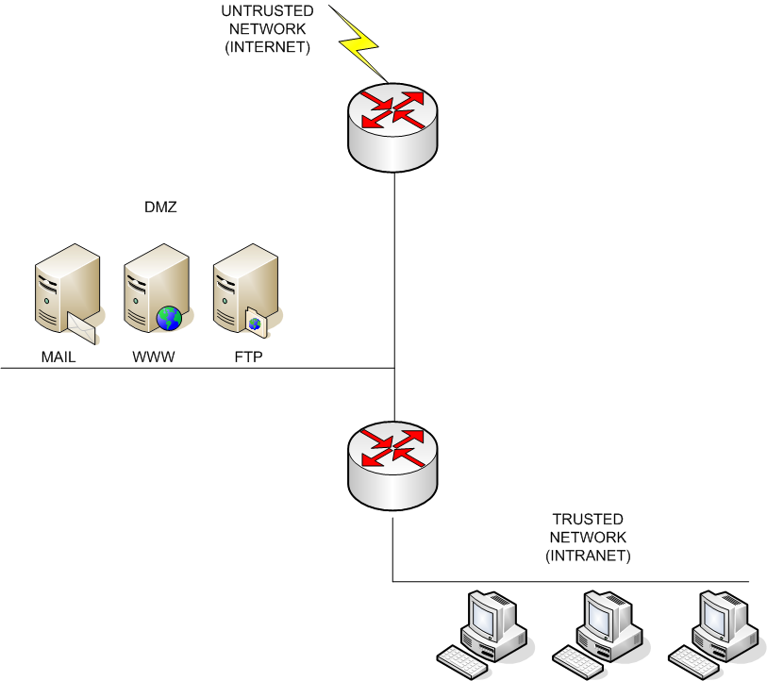
NAT (1/13)
FIREWALL
NAT
The modern corporate network
could look like this. This would
be implemented with two 2-interface
routers or with one 3-interface router.

Slide 118
NAT (2/13)
Network Address Transtation (NAT) addresses three problems:
  #1 shortage of public IPv4 addresses
  #2 hides the implementation of your inner network
  #3 makes you independent of your ISP
NAT translation is done in a router, a firewall or a server
With NAT, you can have overlapping internal addresses in for example in your branch offices
Address translation variations:
  #1 Static address translation
  #2 Dynamic address translation
  #3 Port address translation (PAT)
Private IP address spaces (inside NAT)
  1 A-class address: 10.0.0.0 – 10.255.255.255
  16 B-class addresses: 172.16.0.0 – 172.31.255.255
  256 C-class addresses: 192.168.0.0 – 192.168.255.255

Slide 119
NAT (3/13)
Term |  |  | Definition
Inside |  |  | Addresses located inside of your nw
Outside |  |  | Addresses located outside of your nw
Local |  |  | The IP address physically attached to a device
Global |  |  | The public IP address physically or logically attached to a device
Inside local IP address |  |  | A device inside with a private IP address
Inside global IP address |  |  | A device inside with a public IP address
Outside global IP address |  |  | A device outside with a public IP address
Outside local IP address |  |  | A device outside with a private IP address
NAT terminology

Slide 120
NAT (4/13)
Translation type | Meaning
Static | A manual IP address (and possibly port number) translation is done between inside and outside devices
Dynamic | An automatic IP address (and possibly port number) translation is done between inside and outside devices
Port address translation (PAT) | All the inside IP addresses are mapped to a single outside public IP address. The unique port number (TCP, UDP) is used to distinguish between the inside devices

Slide 121
NAT (5/13)
Static NAT
  The NAT box translates the IP addresses from the outside into inside addresses (one-to-one mapping)
  The NAT box translates the IP addresses from the inside into outside addresses (one-to-one mapping)
  Typically, static NAT is used for the traffic that originates from the outside such as accessing a Web Server in your corporate network
  You have N public IP addresses and N private IP addresses that are mapped statically by the administrator
  Note, that no port numbers are used

Slide 122
NAT (6/13)
Dynamic NAT
  Performs better than static NAT, especially if you translate traffic that comes from the inside
  An IP address pool of public IP addresses is recycled with that originates from the inside
  Typically, used for the traffic that originates from the inside
  Usually the pool of public IP addresses is smaller than the private IP addresses that can generate traffic
  Note, that no port numbers are used

Slide 123
NAT (7/13)
Port address translation (PAT)
  PAT is heavily used today
  One public IP address is overloaded. The TCP/UDP port numbers are used to distinguish between connections
  PAT is used when you have less public IP addresses than you have inside devices needing to get outside
  The following concepts are used with PAT:
    Inside local IP address – original source inside IP address
    Inside local port number – original source port number
    Inside global IP address – public source IP address after translation
    Inside global port number – new source port number after translation
    Outside global IP address – public destination IP address
    Outside global port number – destination port number
  PAT works only with TCP/UDP because of the port numbering
  ICMP with NAT requires some proprietary methods

Slide 124
NAT (8/13)
With the available port addresses, you can have up to 16000 simultaneous connections with PAT
You should add an ACL to your gateway router, that blocks all the outside traffic that has been spoofed with private IP addresses
Typically, you use PAT for the traffic that originates from the inside and static NAT for the traffic that originates from the outside
You can also apply something called Port Address Redirection
  If you have i.e. a Web Server inside (say 10.0.1.2), which should be accessible from the outside
  You still have only one public IP address (say 192.200.100.100), but the gateway router must now perform port address redirection
  A static PAT entry is required in your gateway router
  An incoming packet destined for 192.200.100.100 with the port 80 is redirected to an inside address 10.0.1.2 with the port 80

Slide 125
NAT (9/13)
Disadvantages of NAT:
  Increased complexity
  Some applications require a real IP address
  Compatibility with certain applications
  Problems with security protocols, such as IPSec
  Peer2Peer appications are harder to setup
  Performance reduction

Slide 126
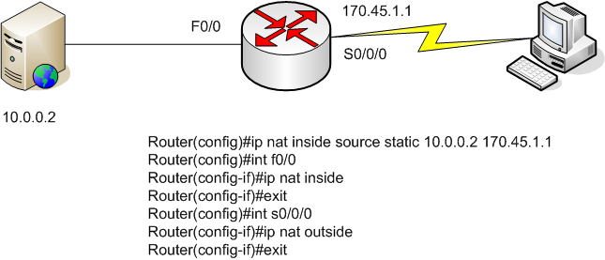
NAT (10/13)
Static NAT
The inside Web Server 10.0.0.2 is statically mapped to a public IP address:
170.45.1.1

Slide 127
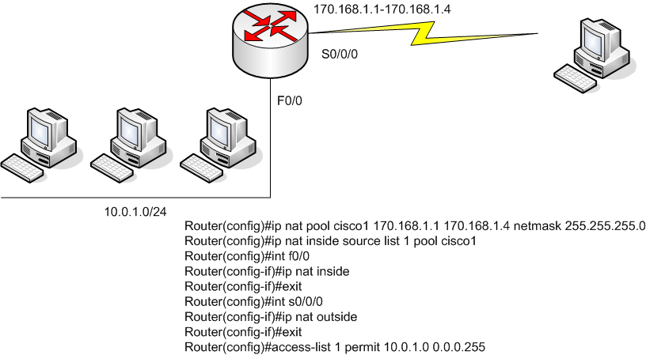
NAT (11/13)
Dynamic NAT
A pool with a name (cisco1) is defined with IP addresses and a netmask.
The ”ip nat inside source list 1 pool cisco1” command tells the NAT box (router) to translate IP addresses that match access-list 1 to an address found in the pool named cisco1.
“access-list 1 permit 10.0.1.0 0.0.0.255” creates an access list number 1 which tags an interesting traffic
(10.0.1.0/24)

Slide 128
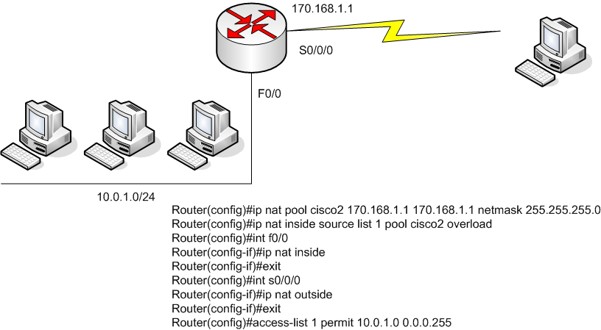
NAT (12/13)
PAT
The only difference between PAT and dynamic NAT configuration is that the pool of
public IP addresses contains only one address. We have also added a command
”overload” in the end of ”ip nat inside source list…” command

Slide 129
NAT (13/13)
To debug NAT:
  Router#sh ip nat translation
To clear a NAT entry:
  Router#clear ip nat translation ?
To clear all NAT entries:
  Router#clear ip nat translation *
To negate a NAT command use no in the beginning of the command, as usual

Slide 130
DHCP (1/3)
DHCP info that the server sends the client:
  IP address
  Subnet mask
  Default gateway address
  DNS domain name
  1 or 2 DNS server addresses
  1 or 2 WINS server addresses (Windows specific info)
  Lease length of the IP address

Slide 131
DHCP (2/3)
Router(config)#[no] service dhcp
Router(config)#ip dhcp pool pool_name
Router(config-dhcp)#network network_number [subnet_mask|prefix_length]
Router(config-dhcp)#domain-name domain_name
Router(config-dhcp)#dns-server IP_address [#2_IP_address]
Router(config-dhcp)#netbios-name-server IP_address [#2_IP_address]
Router(config-dhcp)#netbios-node-type node_type
Router(config-dchp)#default-router IP_address
Router(config-dhcp)#lease days [hours] [minutes] | infinite
Router(config-dhcp)#import all
Router(config-dhcp)#exit
Router(config)#ip dhcp ping timeout time_ms
Router(config)#ip dhcp excluded-address first_IP_address last_IP_address

Slide 132
DHCP (3/3)
You must have configured a router interface (IP address) and enabled it before you can apply a DHCP server
IOS can figure out from the IP settings of an interface, where to apply a DHCP pool

Slide 133
Preassignment
Preassignment
  VLSM-exercise.xlsx (MS-Excel)
  Subnetting exercise. Given a larger subnet block, subnet the network
  Apply VLSM to fit in to the given block size
  The how-to can be found for example in: Todd Lammle: CCNA Study Guide. 6th edition. ISBN: 978-0-470-11008-9. Ch3: Subnetting, VLSM
  Present your solution in the demo session

Slide 134
Literature
Richard Deal: CCNA Study Guide. 3rd edition. ISBN-13: 978-0071497282
Todd Lammle: CCNA Study Guide. 6th edition. ISBN: 978-0-470-11008-9.
  Only ch 3: Subnetting, VLSM
Scott Empson: CCNA Portable Command Guide. 2nd edition. ISBN-13: 978-1587201936. The copy of this book is in the lab class. You should check your IOS command sequence from this book before invoking the commands
http://www.learnios.com/index.php
Internet

